Slide 1
Module Title: Geriatrics Anesthesia Module Code: AnstM-5341 Module ECTS: 5 ECTS Module Duration: 20 Weeks
Instructor: Mr. Hirbo Samuel

Slide 2
Physiological change in Geriatrics
Aging is a universal and progressive physiologic process characterized by:
Declining end-organ reserve,
Decreased functional capacity,
Increasing imbalance of homeostatic mechanisms, and
An increasing incidence of pathologic processes.
Notes:
homeostasis is the state of steady internal, physical, and chemical conditions maintained by living systems. This is the condition of optimal functioning for the organism and includes many variables, such as body temperature and fluid balance, being kept within certain pre-set limits.

Slide 3
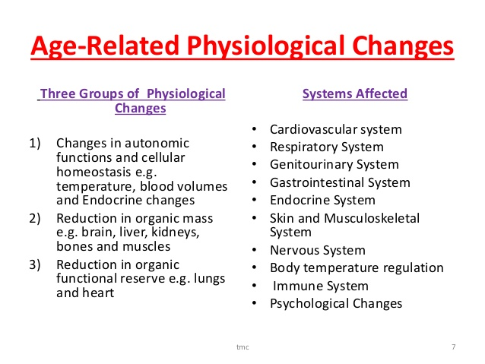
Contiuned
Notes:
The autonomic nervous system is a component of the peripheral nervous system that regulates involuntary physiologic processes including heart rate, blood pressure, respiration, digestion, and sexual arousal. It contains three anatomically distinct divisions: sympathetic, parasympathetic, and enteric.

Slide 4
Age-related physiological changes and common diseases of the elderly.
Normal Physiological Changes
Common Pathophysiology
Cardiovascular
Decreased arterial elasticity
Elevated afterload
Elevated systolic blood pressure
Left ventricular hypertrophy
Decreased adrenergic activity
Decreased resting heart rate
Decreased maximal heart rate
Decreased baroreceptor reflex
Atherosclerosis
Coronary artery disease
Essential hypertension
Congestive heart failure
Cardiac arrhythmias
Aortic stenosis

Slide 5
Age-related physiological changes and common diseases of the elderly.
Normal Physiological Changes
Common Pathophysiology
Respiratory
Decreased pulmonary elasticity
Decreased alveolar surface area
Increased residual volume
Increased closing capacity
Ventilation/perfusion mismatching
Decreased arterial oxygen tension
Increased chest wall rigidity
Decreased muscle strength
Decreased cough
Decreased maximal breathing capacity
Blunted response to hypercapnia and hypoxia
Emphysema
Chronic bronchitis
Pneumonia

Slide 6
Age-related physiological changes and common diseases of the elderly.
Normal Physiological Changes
Common Pathophysiology
Renal
Decreased renal blood flow
Decreased renal plasma flow
Decreased glomerular filtration rate
Decreased renal mass
Decreased tubular function
Impaired sodium handling
Decreased concentrating ability
Decreased diluting capacity
Impaired fluid handling
Decreased drug excretion
Decreased renin–aldosterone responsiveness
Impaired potassium excretion
Diabetic nephropathy
Hypertensive nephropathy
Prostatic obstruction
Congestive heart failure

Slide 7
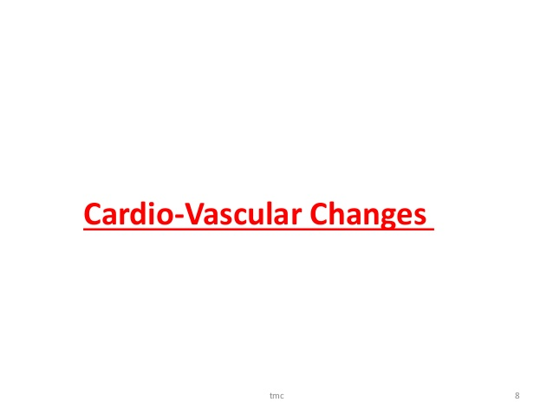

Slide 8
Cardiovascular change
Change
Effect
Large and medium sized vessels become less elastic and less compliant
reduced stroke volume and ventricular contractility
Cardiac conducting cells decrease in number
Catecholamine β adrenergic receptors in the myocardium are down regulated
The non-compliant vascular systems
impairment of autonomic homeostasis and impaired carotid baroreceptor response
raised systemic vascular resistance and hypertension, left ventricular hypertrophy
Cardiac output falls by 3% per decade
making heart block, ectopic beats, arrhythmias and atrial fibrillation more prevalent
decreased responsiveness to catecholamines and sympathomimetic agents
reduced efficacy of vasoconstricting drugs
heart rate cannot always respond to maintain arterial blood pressure
Notes:
The reduction in cardiac output with age increases the arm-brain circulation time for drugs and means intravenous anaesthesia is achieved more slowly and with reduced doses of anaesthetic agent.
Since atrial contraction contributes approximately one third of the volume towards normal ventricular filling, patients with atrial fibrillation suffer a reduction in cardiac output of about 30%.

Slide 9
Cardiovascular change
Postural hypotension is common in the elderly population and may be exacerbated by diuretics, antihypertensive drugs and hypovolaemia.
Ischaemic heart disease is common in older patients, especially in smokers and diabetics.
Structural heart lesions such as valvular heart disease are common.
Intravenous and inhalational agents:
depress cardiac and vascular smooth muscle contractility
impair the baroreceptor response to hypotension.
Notes:
Hypotension should be anticipated with much more greater frequency on induction of general anaesthesia.

Slide 10
Cardiovascular change
Neuroaxial regional anaesthesia techniques may result in significant hypotension
Elderly patients with systolic murmurs should be suspected of having aortic stenosis.
Functional capacity of less than 4 metabolic equivalents (METS) is associated with potential adverse outcomes
Elderly patients undergoing echocardiographic evaluation for surgery have an increased incidence of diastolic dysfunction compared with younger patients.
Notes:
elderly patients often tolerate spinal anaesthesia well, as the non-elastic vascular tree is not as susceptible to vasodilatation caused by sympathetic blockade compared to younger patients.
Diastolic dysfunction prevents the ventricle from relaxing and consequently inhibits diastolic ventricular fi lling at relatively low pressures.
Diastolic dysfunction is NOT equivalent to diastolic heart failure.
Marked diastolic dysfunction may be seen with systemic hypertension, coronary artery disease, cardiomyopathies, and valvular heart disease, particularly aortic stenosis.
Patients may be asymptomatic or complain of exercise intolerance, dyspnea, cough, or fatigue.

Slide 11
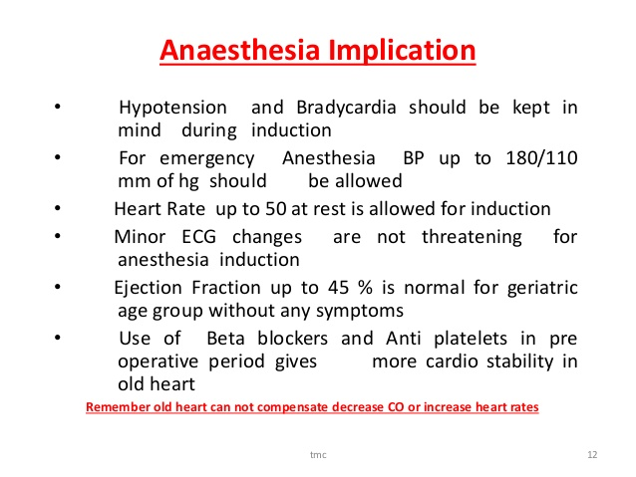
Cardiovascular change

Slide 12
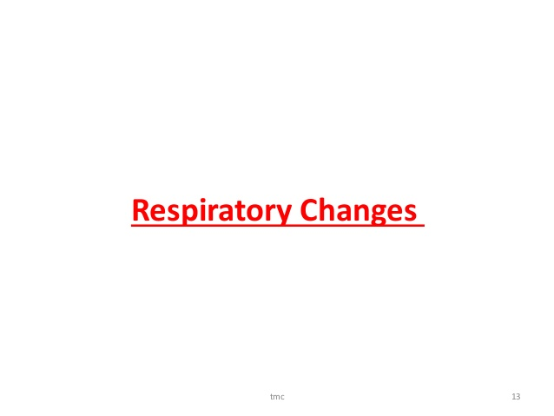

Slide 13
Respiratory change
Change
Effect
Aging decreases the elasticity of lung tissue
Residual volume and the functional residual capacity increase with aging.
Airway collapse
some airways close during part of normal tidal breathing
Decreased respiratory muscle function/mass
intrinsic changes in lung function
overdistention of alveoli and collapse of small airways.
Increases residual volume and closing capacity
Resulting in a mismatch of ventilation and perfusion.
a less compliant chest wall
Increase the work of breathing and make it more difficult for elderly patients to muster a respiratory reserve in settings of acute illness (eg, infection).
Notes:
Closing volume is the volume towards the end of a forced expiration, after which some airways have effectively closed and more of the expired gas comes more from the relatively poorly ventilated regions of the lung. Closing capacity is the volume of gas within the lungs at the point at which airways closure begins.

Slide 14
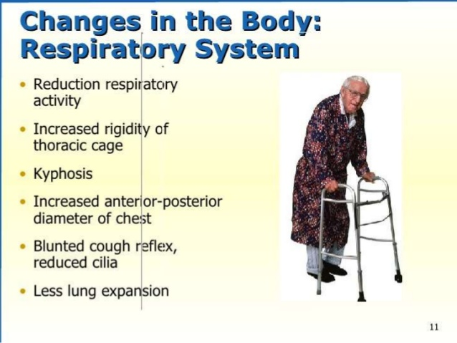
Respiratory change

Slide 15
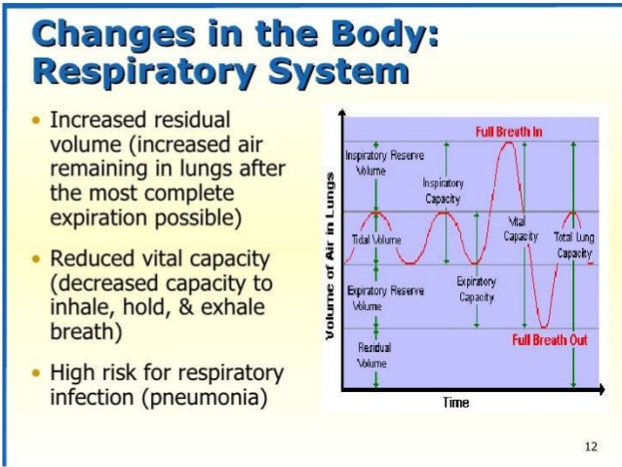
Respiratory change
Notes:
Total lung capacity (TLC), Forced Vital Capacity (FVC), Forced Expiratory Volume in 1 second (FEV¹) and Vital Capacity are all reduced as people age.
Residual Volume (RV) increases and Functional Residual Capacity (FRC) remains unchanged
These changes occur as a result of reduction in elastic support of the airways and leads to increased collapsibility of alveoli and terminal conducting airways.

Slide 16
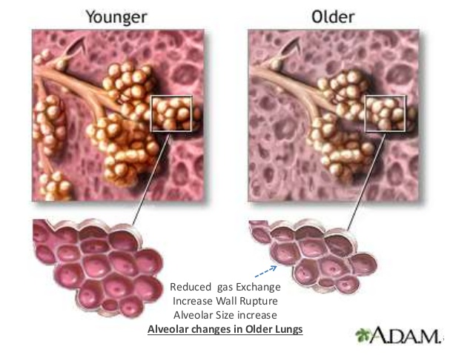
Respiratory change

Slide 17
Respiratory change
Measures to prevent perioperative hypoxia in elderly patients include:
a longer preoxygenation
period prior to induction, increased inspired
oxygen concentrations during anesthesia, positive
end-expiratory pressure, and pulmonary

Slide 18
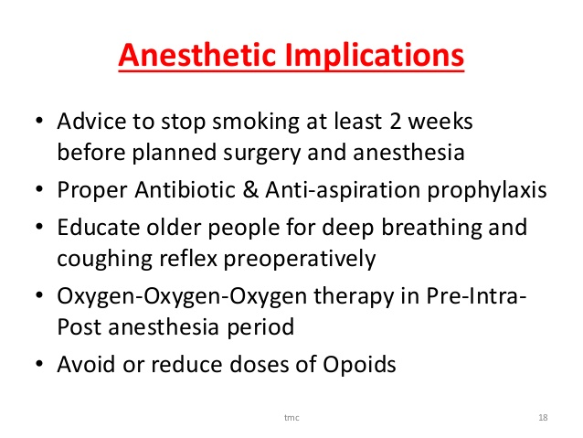
Respiratory change

Slide 19
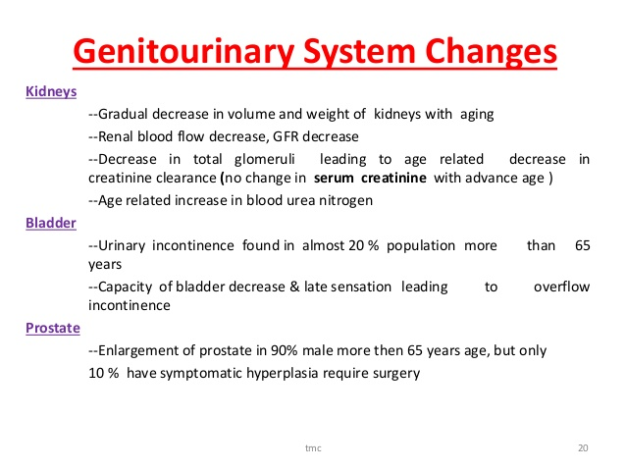
Renal physiology in geriatrics
Notes:
Glomerular filtration rate is thought to decrease by 1% per year over the age of 20 years due to a progressive loss of renal cortical glomeruli.
Prostatism in males can lead to obstructive nephropathy and dehydration is common in the elderly especially during illness.

Slide 20
Factor causing reduction in renal function
A reduction in renal perfusion secondary to reduced cardiac output and atheromatous vascular disease leads to a decline in renal function.
In addition diabetes mellitus is increasingly common, as is the use of nephrotoxic drugs such as non-steroidal anti-inflammatory drugs (NSAID’s) and
angiotensin converting enzyme inhibitors (ACE inhibitors).

Slide 21
contend…..
Though, postoperative renal failure is rare, reduced renal blood flow and decreased nephron mass may increase the risk
Risk factors for acute postoperative renal failure include
advanced age, diabetes mellitus, preexisting renal insufficiency, major vascular surgery, and recent exposure to nephrotoxins.
Sympathetic stimulation, pain, surgical stress, and the use of vasoconstrictive drugs may induce subclinical renal insufficiency.

Slide 22
continued
Renal impairment may lead to a reduced ability to excrete or conserve fluids, electrolyte imbalance and a reduction in the clearance of renaly excreted drugs.
Impairment of Na + handling,concentrating ability, and diluting capacity predispose elderly patients to both dehydration and fluid overload.
The response to antidiuretic hormone and aldosterone is reduced.
The ability to reabsorb glucose is decreased
Therefore, Monitoring of urine output during and after major surgery would be regularly performed.
Geriatric patients do not require a specific fluid regimen.
However, they are less able to achieve hypovolemia or hypervolemia
Notes:
The decreased capacity to handle water and electrolyte loads makes proper fluid management more critical;
elderly patients are more predisposed to developing hypokalemia and hyperkalemia.
This is further complicated by the common use of diuretics in the elderly population

Slide 23
continued
Laboratory results may be deceivingly normal in the elderly since muscle bulk decreases with age resulting in reduced creatinine production.
A small rise in the creatinine level may therefore indicate significant renal impairment.
Creatinine clearance is a more useful test of renal function and can be calculated from a 24-hour urine collection.
An estimation of creatinine clearance can be derived using a patients age, weight and gender using the modified Cockroft-Gault formula.
Creatinine Clearance (ml/min) = (140-age) x Weight (Kg) x Constant
Serum Creatinine (μmol/L)
Constant for males = 1.23
Constant for females = 1.04

Slide 29
References
• Millers Anesthesia, 8th Edition
• Clinical anesthesia, Barash 8th Edition
• Morgan and Mikhail’s clinical anaesthesiology 6th edition

